Slide 1
CLASSIFICATION OF FRACTURES
MR. KOROS E.K.,
BSc.N, UoN, BLS, ACLS, LECTURER.

Slide 2
Introduction
Injuries to the musculo-skeletal system include: fractures, dislocations, sprains, strains, contusions, spinal/vertebral column injuries and head Injuries
A fracture is a break or crack in the continuity of a bone.
It can be partial/incomplete or complete break
It can occur in any part of the body e.g. skull, jaw, spine, collar bone, extremities, ribs, pelvis etc.
A fractured bone may damage other organs and major blood vessels leading to serious complications.
A dislocation is pulling bones out of position in a joint e.g. hip dislocation, shoulder dislocation.
A dislocation may result in nerve damage, strains and sprains.

Slide 3
Introduction Cont’…
Displacement refers to movement of bone away from its original/normal position due to twisting, rotation or angulation forces
Orthopaedics is a branch of medicine that deals with the management of bones or muscle deformities
Orthopaedic Nursing is a specialty that deals with nursing care of diseases and injuries of bones, joints and muscles

Slide 4
Causes of Fractures;
Direct blow/violence e.g. RTA impact
Indirect force/violence e.g. fall from a height, a twist or wrench; sudden twist in the bathroom etc.
Crushing force e.g. Heavy falling object, Boxing
Extreme muscle contraction (avulsion) e.g. in sports, torture; sudden strong contraction of quadriceps extensor group of muscles can fracture patella, etc.
Pathological (diseases) causes e.g. osteomyelitic fracture, rickets, tuberculosis (TB Bone), bone marrow inflammation, bone cancers/tumors, some congenital disorders etc.

Slide 5
Types of Fractures
Complete fracture; there is a break across the entire bone
Incomplete fracture: bone breakage occurs partially
Open fracture; (Gustilo classification) bone breaks and skin and/or mucus membrane is involved thus bone is exposed on the surface. Carries higher risk of infection!
Closed fracture; bone breakage without alteration of skin (skin above the fracture remains intact, not broken). May damage nearby tissues and blood vessels. Internal bleeding is also a major risk!
Compound fracture: involves two or more bones and skin is broken. May be complete or incomplete, open or closed.

Slide 6
Cont’…
Comminuted or Impacted fracture; one bone crushes over another with release of smaller bone particles/fragments in several places (comminuted) or pushed into one another and tightly wedged together (impacted).
Greenstick fracture; characterized by bones involved bending like a green twig (branch of young tree). Common among young children aged 5-12 years whose bones are still fairly soft & developing.
Pathological fractures; caused by infectious diseases of the bones

Slide 7
Cont’…
9. Complicated fractures;
This is whereby the fracture not only damages the bone but injury to the internal organs also occurs e.g.
Fracture of the skull where the broken bones may press on the brain
Fracture of the vertebrae where the broken bones may be pressing on and damaging the spinal cord.
Fracture of the rib where the broken bone may pierce the lung

Slide 8
Classification of Fractures
Fractures are broadly classified according to:
Aetiology or Cause e.g. sudden injury, fragility, fatigue, pathological etc.
Pattern of fracture line e.g. transverse, obligue, spiral, comminuted, compression, green-stick etc.
Displacement; angulation, rotation, change of bone length, loss of alignment
Clinical features; i.e. degree of break in continuity of the bone i.e. complete, incomplete fractures and/or communication to the environment i.e. open or closed
Character of fracture i.e. comminuted, impacted or segmental
Location of fracture i.e. proximal, mid-shaft, distal

Slide 9
Cont’…
Whether Stable or Unstable according to degree of displacement with ligament injury e.g.
Stable fracture - # vertebral column with intact posterior vertebral column ligaments
Unstable fracture - # vertebral column with raptured posterior vertebral column ligaments

Slide 10
Classification of Fractures According to Aetiology

Slide 11
Fractures Caused Solely by Sudden Injury:
Form the largest group of fractures by far
Occur through bone that was previously free from disease
May be caused by direct or indirect violence
Direct violence e.g. metatarsal bone fractured by falling, heavy weight/object on the foot
Indirect violence; transmitted along bone e.g. head of radius fractured in a fall on the outstretched hand, fracture of clavicle in a fall on the shoulder

Slide 12
Fragility Fractures:
Fractures associated with generalized bone weakness resulting from conditions such as osteoporosis (loss of bone mass to the level below range of an individual of a similar race and sex)
Seen mostly in elderly patients
Occur in 40% of women and 14 % men ≥ 50 years
WHO predicts that by 2050, there will be 6.5 million hip fractures worldwide
Risk factors for fragility fractures include: low bone density, falls, nature of floor and environment and bone strength (BMD-bone mineral density)

Slide 13
Fatigue (Stress) Fractures:
Occur from repeated stress to bone
Common in athletes or new military recruits
Occur when the rate of microdamage exceeds rate of repair whereby microdamage accumulates and progresses to a complete fracture across the full width of the bones
Most of these fractures are confined to bones of the lower limb e.g.
Metatarsals (march fractures),
Shaft of fibula,
Shaft of tibia,
Neck of femur

Slide 14
Pathological Fractures:
Occur in bones already weakened by disease
Created by a level of force that would not have resulted in a fracture in a healthy bone
Bones give way from trivial violence or even spontaneously
Examples;
Osteomyelitic # (infection-Osteomyelitis)
Osteomalacic # (Rickets/Osteomalacia – deficient minerals, calcium, vit D intake
Osteosarcoma # (Tumors)
Osteogenesis imperfecta # (congenital)
Osteoporotic # (deficiency of both organic and inorganic components of bone leading to reduced total bone mass
Paget’s disease (Miscellaneous)

Slide 15
Classification of Fractures According to Pattern

Slide 16
Introduction
Fractures are often designated by descriptive terms denoting the shape, direction and manner of fracture surface formed as seen on radiographs
This feature categorizes the fractures into the following patterns;
Longitudinal/Linear fracture: bone break follows a straight line along the long axis of the bone
(draw a diagram)

Slide 17
Transverse fracture: bone breaks transversely across the short axis of the bone
Caused by angulation force rather than a twisting force
Common among long bones
(draw)

Slide 18
Oblique Fracture :
Bone breakage follows a diagonal manner, occurring at an angle across the bone,
Less stable than a transverse fracture.
(draw)

Slide 19
Spiral Fracture:
Bone breakage follows a spiral manner
Caused by a twisting force around the shaft of the bone
(draw)

Slide 20
Comminuted or Impacted fracture:
One bone crushes over another with release of smaller bone fragments/particles in several places (comminuted)
When the bone particles are pushed into one another and tightly wedged together or become interlocked such that there is no movement at all between them, then they are said to be impacted.
(draw)

Slide 21
Compression or Crush fracture:
fractured bone causes a depression e.g. skull fracture
This type of fracture does not always lend itself well to anatomical reduction, because the spongy bone substance may be crushed and compressed and cannot be restored fully to its original trabecular form.
(draw)

Slide 22
Greenstick fracture:
Characterized by bones involved bending like a green twig (branch of young tree).
Common among young children aged 5-10 years whose bones are still fairly soft & developing
Mainly caused by angulation force; sometimes longitudinal compressional forces.
Breaks are usually incomplete due to angulation force that tends to bend the bone at one cortex and buckle or break it at the other, hence these fractures are sometimes referred to as buckle fracture or torus fracture
Severe violence may sometimes cause complete greenstick fractures
(draw)

Slide 23
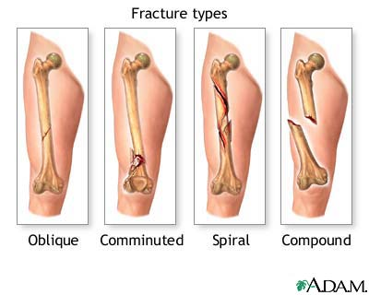

Slide 24
Fractures Cont’…

Slide 25
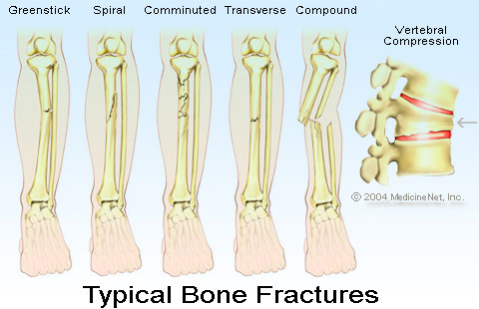
Fractures Cont’…

Slide 26
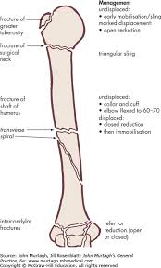

Slide 27
Classification of Fractures According to Displacement

Slide 28
Introduction
Displacement of fractures is defined in terms of abnormal position of the distal fracture fragment in relation to the proximal bone
This feature describes fractures in three main ways;
Undisplaced/Non-displaced Fractures
Partially Displaced Fractures
Completely Displaced Fractures

Slide 29
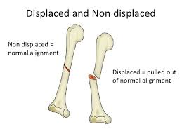

Slide 30
Cont’…
In non-displaced fractures, the bone cracks either part or all of the way through but does move and maintain it’s proper alignment
Displaced fractures refer to change of original position in the alignment of the fractured bone
Partial displacement; fractured bones are displaced but still joined together at some point
Complete displacement; fractured bones are completely separated from each other and displaced from their original position

Slide 31
Cont’…
There are four main types of displacement of fractures;
Angulation or Translation
Rotation
Change of Bone Length
Loss of Alignment
? LARA

Slide 32
Angulation/Translation
Angulation is an abnormal bend or curve
In angulation, the normal axis of the bone has been altered such that the distal portion of the bone points off in a different direction
In translation, sideways motion/displacement occurs
Angulation is described using terms such as;
Dorsal/palmar angulation
Varus (medial angulation)/valgus (lateral angulation)
Radial/ulnar angulation
(draw diagram)

Slide 33
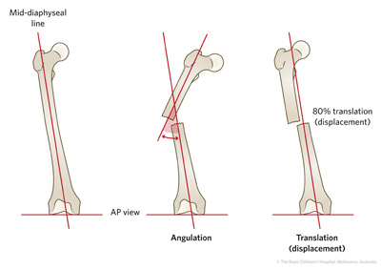

Slide 34
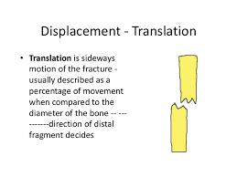

Slide 35
Rotation
This is a type of displacement whereby there has been a rotation of the distal fracture fragment in relation to the proximal portion
Rotation may be internal or external
It is often difficult to see on an x-ray but relatively simple to determine on clinical examination, most easily seen when looking at orientation of joints above and below a fracture
It may result in significant disability if fracture isn’t reduced appropriately
(draw diagram/image)

Slide 36
Change of Bone Length
This is a type of displacement whereby proximal migration of the distal fracture component resulting in either shortening of the overall bone length, distraction (increased overall bone length) or impaction (shortening of bone without loss of alignment).
Shortening of the bones in fractures may lead to mal-union. An oblique fracture is more readily shortened than a transverse fracture
(draw diagram/image)

Slide 37
Loss of alignment (malalignment)
This refers to the actual loss of the bones original alignment along its long axis due to fracture
Usually accompanied by some degree of angulation, rotation or change in bone length.
(draw diagram/image)

Slide 38
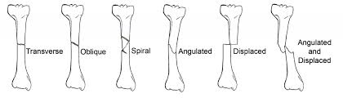

Slide 39
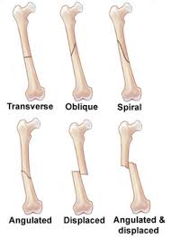

Slide 40
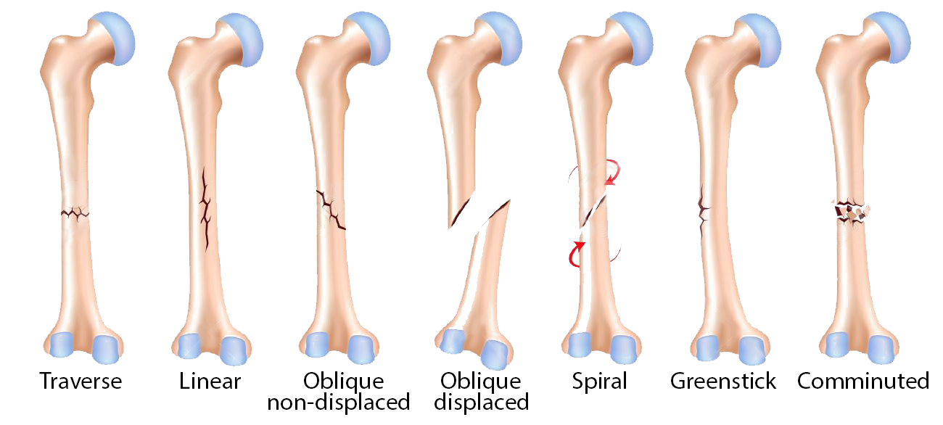

Slide 41
Classification of Fractures According to Clinical Features

Slide 42
Open Fractures (Simple or Compound);
Bone breaks and skin and/or mucus membrane is involved thus bone is exposed on the surface.
Skin wound and broken bone visible on the skin surface hence wound communicates directly with the fracture
Carries higher risk of infection from external sources!
Closed Fractures (Simple Fracture);
Bone breakage without alteration of skin (skin above the fracture remains intact, not broken).
No communication between fracture site and exterior of the body
May damage nearby tissues and blood vessels.
Carries less risk of infection unless operated on
Internal bleeding is a major risk!

Slide 43
Complete fractures; there is a break across the entire bone such that the fractured bones are completely separated from each other
Incomplete fracture: bone breakage occurs partially
Compound Fractures:
Involves two or more broken bones
Skin is also broken.
Direct communication exists between body surface and fractured bone ends
May be complete or incomplete, open or closed.

Slide 44
ANY QUESTIONS SO FAR ???

Slide 45
Gustilo Classification of Open (Compound) Fractures

Slide 46
Gustilo Anderson classification of open fractures is the most widely accepted classification system
It is used to guide management of compound fractures, with highest grade injuries associated with higher risk of complications
Criteria for fracture severity classification is based on;
Amount of energy involved
Extent of soft tissue damage
Extent of contamination
Potential for complications

Slide 47
Gustilo (Anderson) Classes of Open Fractures
Gustilo Grade/Type I: low energy, open # with minimal soft tissue damage; wound clean, < 1cm in length
Gustilo Type II: higher energy, open # with wound laceration > 1cm but < 10cm length without extensive soft tissue damage; flaps, avulsions, minimal contamination

Slide 48
Gustilo IIIA: high energy trauma (gunshot and farm injuries) regardless of wound size; open # with adequate soft tissue coverage of a fractured bone despite extensive soft tissue laceration or flaps
Gustilo IIIB: high energy; open # with extensive soft tissue loss; inadequate cover; periosteal stripping and bone damage; associated with massive contamination; will often need further soft tissue coverage procedure i.e. free or rotational flap
Gustilo IIIC: high energy, open # associated with vascular (arterial) injury requiring repair, irrespective of degree of soft tissue damage/injury

Slide 49
THIS IS THE END OF THE LESSON FOR NOW…
HOPE YOU ENJOYED IT !
THANK YOU ! ! !

Slide 50
References/ Further Readings
David, L., Hamblen, A., Hamish, R. and Simpson, W. (2007.) Adam’s Outline of Fractures, 12th Ed. Churchill Livingstone, Elsevier.
Dandy, D. and Edwards, D. (2009). Essential Orthopaedics and Trauma. 5th Ed. Churchill Livingstone, Edinburgh
Kenneth, A, et al (2010). Handbook of Fractures. 4th Ed. Wolters Kluwer, Philadelphia
McRae, S. and Esser, M. (2008). Practical Fracture Management. 5th Ed. Elsevier Churchill Livingstone, Edinburg
Sherry, E. and Bokor, D. (1997). Sports Medicine – Problems and Practical Management. Greenwich Medical Media, London
Louis, S., David, W. and Selvadurai, G. (2010). Apley’s Syetem of Orthopaedics and Fractures, 8th Ed.

Slide 51
THANK YOU

